Slide 1


IoT102t Weather Station Project FALL2024
Group 2: SE180768 Nguyen Huynh Nhu An SE180722 Hoang Van Huy SE180732 Nguyen Dinh Luc SE182707 Ta Giang Nam SE180670 Ho Dinh Anh

Slide 2
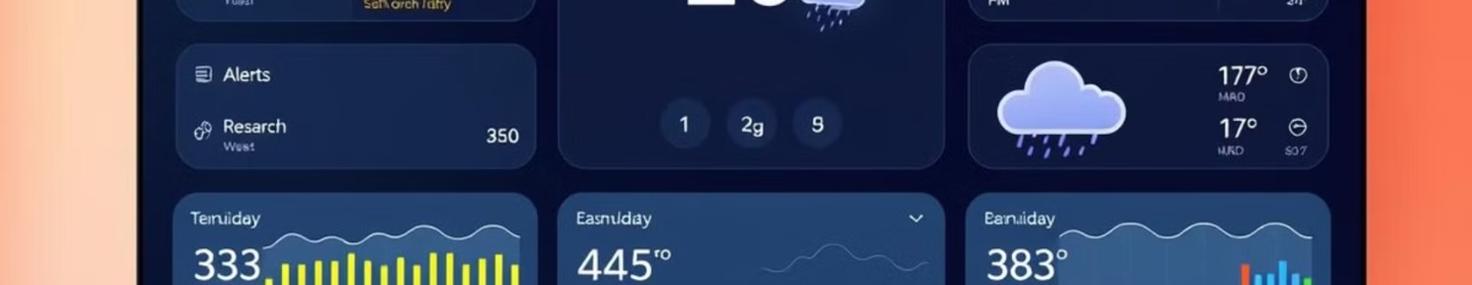
Introduction
Real-Time Monitoring
Alerts and Notifications
Our Weather Station continuously monitors indoor and outdoor environmental conditions, providing users with real-time data on temperature and humidity.
The system sends alerts via Telegram when conditions exceed predefined thresholds, ensuring timely responses to potential issues.

Slide 3
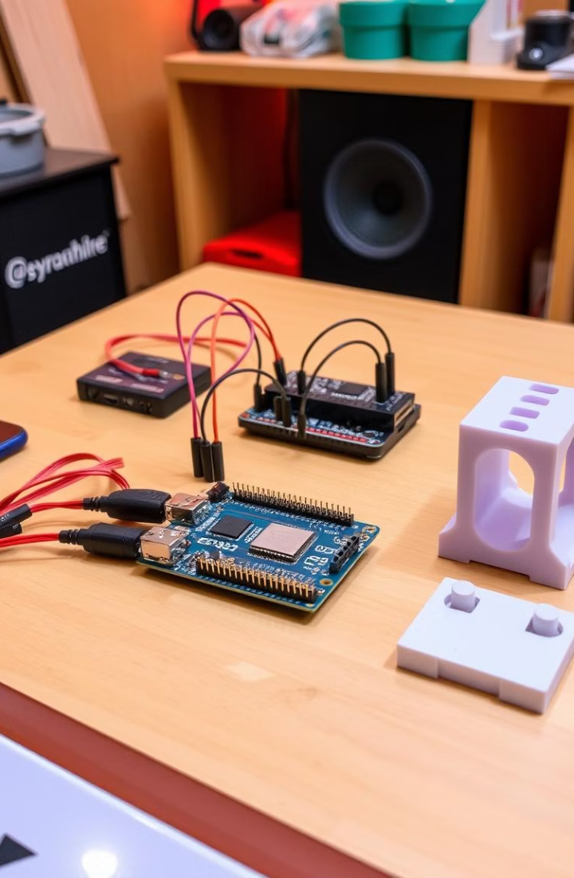
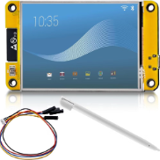
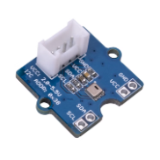
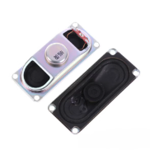

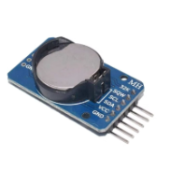
Project Components
ESP32-2432S028 Board
AHT20
Speaker
The brain of the system, integrating Wi-Fi, I2C communication, and TFT2.8.
Temperature and humidity sensors provide real-time data on indoor conditions.
Provides audible alerts for significant temperature changes.
3D-Printed Stand
DS3231
Customizable housing for the system components.
Real-Time Clock module that keeps track of time

Slide 4
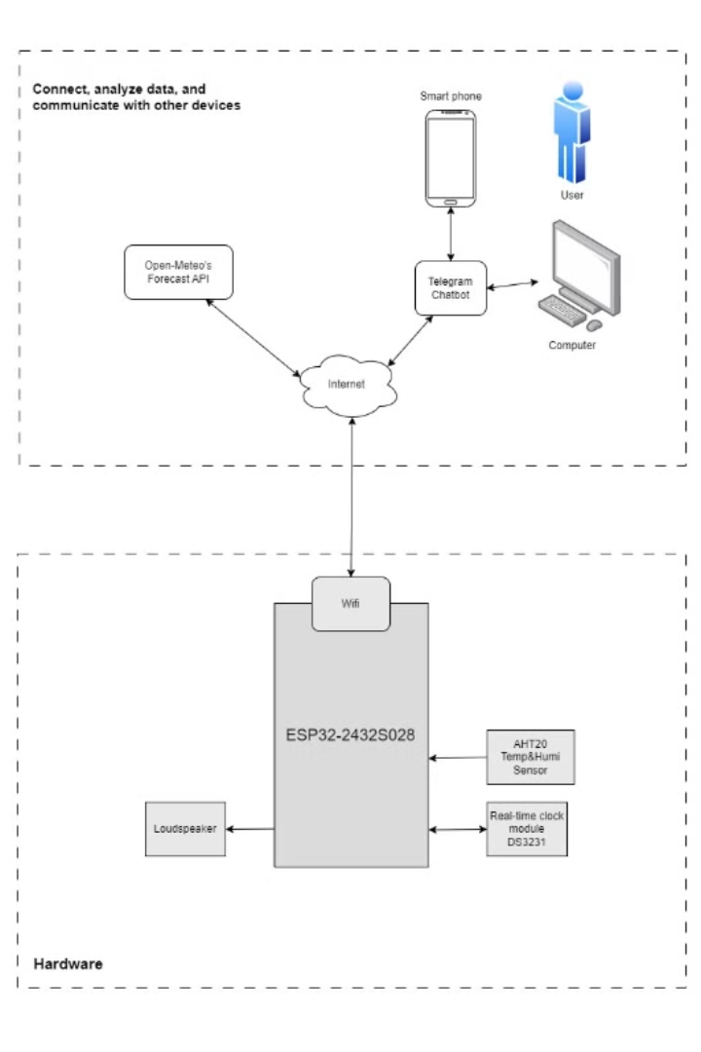





System Model and Block Diagram
AHT20 gathers temperature and humidity readings.
DS3231 provides timekeeping for data logging and alert scheduling.
ESP32 processes data and transmits it to the cloud.
Data analysis triggers alerts as needed.
Telegram bot delivers user alerts.

Slide 5

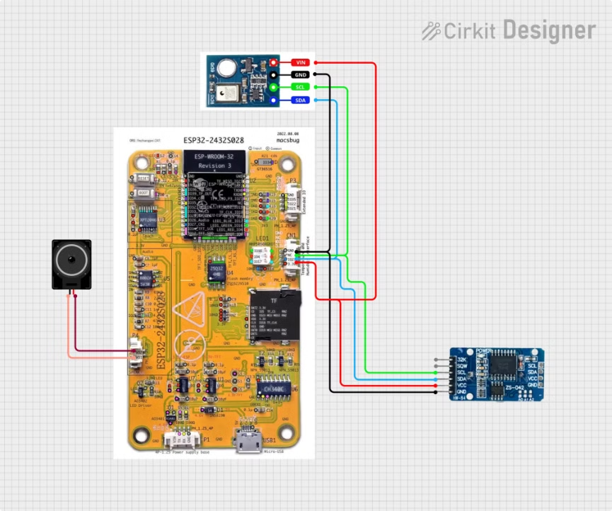
Circuit Schematic
Electronic Circuit/Hardware Interfacing Circuit schematic showing ESP32-2432S028 microcontroller interfaced with peripherals.
Key connections: VCC (3.3V): Supplies power to DS3231 (RTC) and AT1120. GPIO27 (SDA): Serial Data Line for bidirectional data transmission. GPIO22 (SCL): Serial Clock Line for synchronized communication. GND: Common ground for all components. I2C Protocol: Efficient communication with only two lines (SDA & SCL), minimizing wiring and ensuring stable operation.

Slide 6

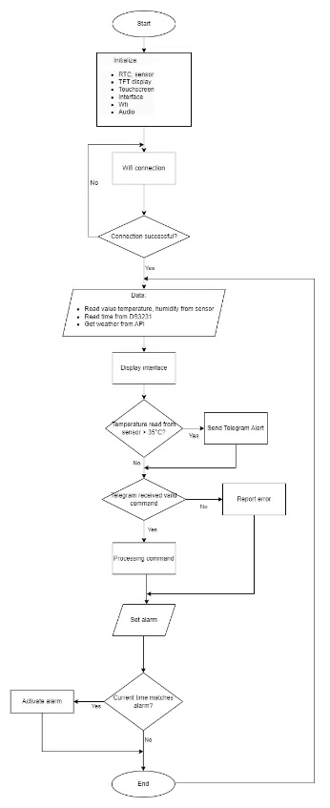
Programming Flowchart
1
Start & Initialize: Activates components (sensor, RTC, Wi-Fi, display).
2
Wi-Fi Connection: Ensures stable connection.
3
Data Retrieval: Reads temperature, humidity, time, and weather info.
4
Display: Shows data on the interface.
5
Temperature Check: Sends Telegram alert if temperature > 35°C.
6
Command Processing: Processes valid Telegram commands.
7
Set & Activate Alarm: Sets an alarm and triggers it at the specified time.
8
End: Loops or terminates based on logic.

Slide 7
Applications: Benefits of the Weather Station
Home Climate Control
Emergency Alerts
Energy Efficiency
Our weather station helps maintain optimal indoor climate conditions, promoting a healthy and comfortable living environment.
By providing timely notifications for critical conditions, our system helps mitigate potential risks and ensures safety.
Real-time monitoring allows for precise temperature control, optimizing heating and cooling systems for cost savings and reduced energy consumption.
Smart Home Integration
Health and Safety
The system can seamlessly connect with other smart home devices, enabling automated actions based on real-time environmental data.
By providing continuous monitoring and alerts, our weather station promotes a healthier and safer living environment for individuals and families.

Slide 8


